Slide 1

Maximizing Customer Value and Retention through Customer Analytics
Microsoft Azure HiPo Team
Solution Blueprint Overview

Slide 2
Customer Analytics Azure Solution Blueprint
Objectives
Microsoft Azure HiPo Value Proposition
Customer Analytics on the Azure Platform
Discover your most profitable customers
What are the buying patterns of your customers?
Which Customer are most likely to Churn and Why?
Engaging with Azure HiPo Team

Slide 3

360 Degree View of the Customer
Apply lifetime value for customers and customer segments to understand the profitability of your customer base.
Understand what drives your customer’s buying behaviors and what factors may cause them to go somewhere else.
Leverage that data to make better business decisions that will increase your customer profitability, lower costs to find new customers and grow your revenue opportunities.

Slide 4
Microsoft Azure HiPo Team of Cloud Solution Experts
CSA
DSA
PSS
Experienced senior architects focused on building cloud-first applications that are highly-available, highly-scalable and transformative for your business
Dedicated database, analytics, business intelligence, data warehouse and Big Data architects with decades of experience in Microsoft, open source and non-Microsoft data platforms
Azure experts dedicated to your long-term success in building Azure cloud-first solutions that will give you a strategic business advantage with access to abundant resources throughout Microsoft and the vast Microsoft partner ecosystem

Slide 5
Microsoft Azure HiPo Team Pre-Archictected Solutions
Hyper-scale
Enterprise Grade
Hybrid
Cloud Solutions Built 100% for the Cloud on Microsoft Azure

Slide 6



Business Transformation through Customer Analytics
Customer Segmentation
New Revenue Streams
Marketing Efficiency
Understand your customers through segmentation so that you can better understand what drivers their purchasing patterns and propensity to churn.
Make better product roadmap decisions through Azure Advanced Analytics. Drive new revenue streams forward with cross-sell and up-sell opportunities that were not possible before without this analytical insight.
Deep understanding of customer buying patterns combined with predictive analytics will produce smarter, more cost-effective marketing campaigns and help to drive your business’ internal buying and marketing processes.

Slide 7

Value Realization Scorecard
Measure business impact of Customer Analytics
Optimize Your Business
Business Outcomes/Results
Customer
Improved customer experience
Efficient service
Personalized and custom products and offers
Employee
Provide better service based on customer insight
Access relevant information from throughout the company
Easily communicate and collaborate with each other
Reduced customer churn
Improved Revenue (cross/up sell)
Improved customer satisfaction
Data-driven business decision making
Innovation
Increased innovation in delivering end-to-end experiences in a customer’s journey
Enhanced market insights
Accelerated pace of new ideas generation (Marketing/Sales)
Brand
Personal service
Insightful offers
Innovative products and services

Slide 8
Azure HiPo Team Business Solution Process
Customer Analytics
Provision POC on your Azure non-prod subscription
Establish data flow from source systems
Validate scalability, performance and reliability
Gather additional new or external data sources
Data
Collection
Data Engineering
Capability and Analytics Mapping
Operationalize and Make Ready for Production
Data quality and transformation reviews
Data cleaning and data validation
Use small sample data sets to prove theorem
Data Engineering
Develop BI Reporting/Dashboard capabilities
Develop Machine Learning/Predictive Analytics models
Present POC / prototype to business stakeholders for review and acceptance
Capability and Analytics Mapping
POC/Prototype
HiPo Team provides POC assets, training and instructions for customer and partner
Partner implements solution with additional security and privacy requirements
Partner Execution

Slide 9
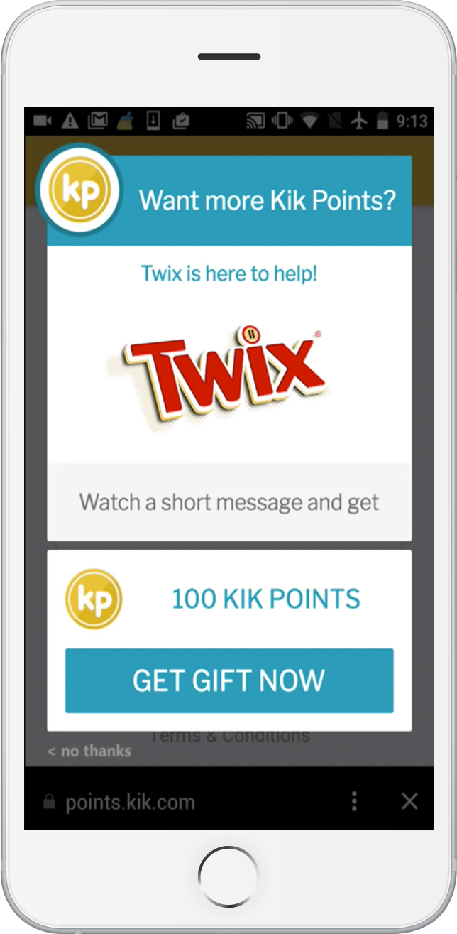

Digital advertising company gets answers from terabytes of data using Azure
Increasing sales requires building an emotional connection with consumers. Finding innovative ways to establish customer connections is complicated. It’s no longer just about developing a compelling message and targeting a user.
“The Azure platform not only helps us gain fast insights, but it also enables us to hook up technologies like Azure Machine Learning so that we can create predictive models, change data in real time, and deliver the right ads to the right people.” - Christopher Beach, MediaBrix Sr VP of Engineering
Using Power BI … “Customers will be able to riff on any visualization that we give them,” says Beach. “And then the really awesome thing is that when we need to modify the content, I can make changes to it, and everyone automatically gets those updates.”
Innovative use of Cloud has propelled MediaBrix far ahead of the competition. “We can tell customers who’s actually consuming their advertising. For example, we might say that to target women aged 24 to 35 who have children, they’ll need to do so between 6 and 8 AM on the East Coast …” says Beach. “It’s mind-blowing to tell them that, because they’re not getting that level of intelligence from anybody else.”

Slide 10

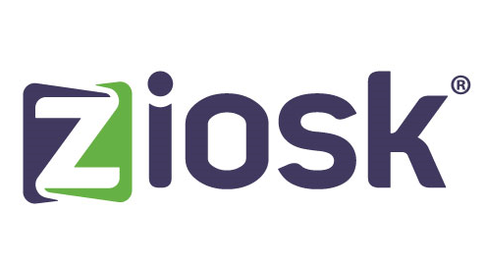
What game will you want to go with that burger? Ziosk may already know.
Azure Big Data and Machine Learning will predict your preferences and serve them up as part of a better dining experience. The goal is to create personalized experiences that result in happier guests and more business.
“Our challenge is to understand what drives guest behavior and use that insight to give guests more of what they want, when they want it,” says Kevin Mowry, Chief Software Architect at Ziosk.
Ziosk’s customers—the restaurants—now receive actionable intelligence in real time to in-store managers that can significantly improve the operations of most restaurants.
“Until now, we haven’t had the ability to optimize the guest experience based on their specific interactions with the devices. With Azure, we can close the loop.” - Kevin Mowry, Ziosk Chief Software Architect

Slide 11

Real Madrid C.F.
Improve fan engagement and experience
As the leading sports franchise in the world, Real Madrid has more than 100 championships and a passionate fan base. But what the football club didn’t have was a way to directly engage with its 450 million global supporters.
“Using the Microsoft Cloud, we are building a way of understanding who our fans are, where they are, and what they want from us.”
– José Ángel Sánchez, CEO, Real Madrid C.F.
Business Needs
Engage with fans in more personal ways to increase revenue, customize marketing initiatives, and reinforce the club’s leadership position in the worldwide sports industry.
The Solution
Implement a comprehensive platform-as-a-service solution to collect the data Real Madrid needs and to create personalized fan experiences and thrive
Results
One-to-one relationships with fans increases engagement
Targeted, customized marketing
Near-real-time campaigns
Transparent user interactions with content and advertising
Notes:
Real Madrid
Links to case study: http://aka.ms/realmadridstory
Summary: As the leading sports franchise in the world, Real Madrid has a lot to brag about, including more than 100 championships and a passionate fan base. But what the football club didn’t have was a way to directly engage with its 450 million global supporters. That changed when it implemented a comprehensive technology solution based on the Microsoft Cloud platform.
Now, Real Madrid is able to connect more closely with its fans and give them a better overall experience, while analyzing social media data and other information to customize marketing campaigns and boost revenues.
Business and Technology Need: Despite all its on-field success and ardent support, Real Madrid was still missing one thing: the ability to connect more closely with its fans. By engaging with its fans in more personal ways, Real Madrid wanted to increase revenue, customize marketing initiatives, and reinforce the club’s leadership position in the worldwide sports industry.
Solution: Microsoft Services worked with Real Madrid to build a comprehensive platform-as-a-service solution, based on the Microsoft Cloud and Office 365 platform that combines with Azure to collect the data Real Madrid needs to create personalized fan experiences and thrive.
Benefits:
Providing the engagement fans crave and the ability to analyze their behavior
Simplified social account and secure logins
Mobile app available in iOS, Android and Windows
Ability to collect, analyze and respond to social messages streaming in from social media like Twitter and Facebook
Creating near-real-time marketing campaigns

